Slide 1
HAP618-FINAL PROJECT DIGIT-O-DENTAL CLINIC WEBPAGE WITH APPOINTMENT BOOKING SYSTEM
LAKSHMI INDIRA KUPPA

Slide 2
AGENDA
1.Background and Project Description
2.Project Overview
3.Project Design and Implementation
4.Functionality Demonstration
5.Lessons learned and Future enhancements.
6.Conclusion and References

Slide 3


BACKGROUND
The healthcare industry is experiencing a paradigm shift towards digital solutions that offer convenience and accessibility to patients. The traditional method of scheduling appointments and managing patient information in dental clinics often involves manual processes that can be time-consuming and prone to errors. In response to the evolving needs of patients and healthcare providers, this final project introduces a comprehensive platform tailored for dental offices. The focal point of this endeavor is to empower patients by enabling them to effortlessly schedule appointments remotely by providing essential demographic and diagnostic details on the webpage.

Slide 4

PROJECT DESCRIPTION
This Python-based dental clinic management platform represents a significant step towards revolutionizing the dental healthcare landscape. By combining technology and healthcare expertise, the platform seeks to elevate patient experience, increase operational efficiency for dental clinics, and contribute to the overall advancement of oral healthcare in the digital age. The platform centers around a user-friendly website for dental clinics, equipped with demographic and diagnostic questionnaire coupled with an efficient appointment booking system. This amalgamation of technology and healthcare aims to address the evolving expectations of patients while bridging the technological gap in the field of dental care.

Slide 5
TOOLS USED
PYTHON-
Purpose: Primary backend language. I will be using Git Bash to run my python code.
Functions: Manages logic for appointment scheduling, data processing, and user interactions.
Text Editor- I will be using Sublime text editor to write my code.
FLASK-
Role: Micro web framework in Python.
Application: Utilized for web development.
Advantages: Enables creation of dynamic, interactive web pages for seamless user experience.
EXCEL-
Database Solution: Unconventional choice for data storage.
Functionality: Stores patient information and appointment history.
Integration: Familiar interface, easy integration with existing office workflows.
HTML and CSS-
HTML: Structures web pages, defines content and layout.
CSS: Styles and enhances visual presentation.
Combined Effect: Creates an intuitive and user-friendly interface.

Slide 6

The files/folders and the apps used for running the codes are shown.

Slide 7
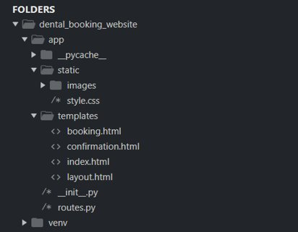
PROJECT DESIGN AND IMPLEMENTATION
First , a virtual environment is created named 'venv' with this we ensure a clean, organized, and reproducible environment for our project.
These are the folder and file names used in the project.
1.The python code is saved in routes.py
2.The frontend html page is saved as index.html,confirmation.html and booking.html.
3.CSS file is style.css in static folder.
4.images used on the webpage are stored in static folder.
5.All these files are under a folder named 'app'

Slide 8
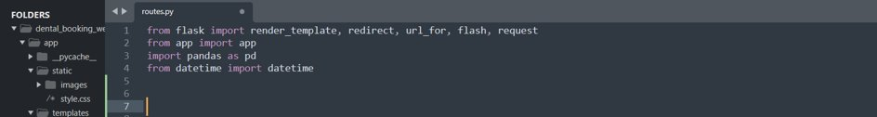
We import necessary modules-
render_template: Used to render HTML templates.
redirect and url_for: Used for redirection within the application.
flash: Used for flashing messages to be displayed to the user.
request: Allows access to data submitted in the request.
pandas: Imported but not used in this snippet. It might be intended for more advanced data manipulation.
datetime: Used to handle date and time information.

Slide 9
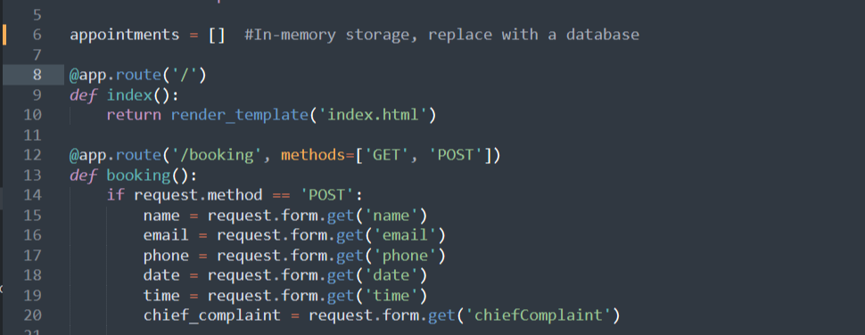

Slide 10
The statement checks if the HTTP request method is POST. It is commonly used to differentiate between a page visit (GET request) and form submission (POST request).
Form Data Extraction (POST Request):
The indented block under the if statement is executed when the request method is POST.
The following lines extract data from the form submitted in the POST request:
name = request.form.get('name'): Extracts the value associated with the form field named 'name'.
email = request.form.get('email'): Extracts the value associated with the form field named 'email'.
phone = request.form.get('phone'): Extracts the value associated with the form field named 'phone'.
date = request.form.get('date'): Extracts the value associated with the form field named 'date'.
time = request.form.get('time'): Extracts the value associated with the form field named 'time'.
chief_complaint = request.form.get('chiefComplaint'): Extracts the value associated with the form field named 'chiefComplaint'.

Slide 11
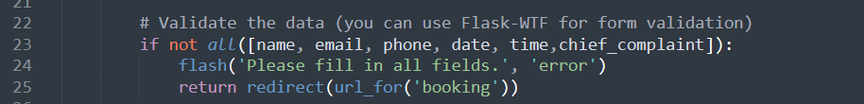
The all([name, email, phone, date, time, chief_complaint]) expression checks if all the specified fields have non-empty values. It validates the data.
flash('Please fill in all fields.', 'error'):
If any of the fields is empty (validation fails), a message is flashed to the user.
Flash messages are typically used to provide feedback to the user. In this case, it's indicating that they need to fill in all fields.
return redirect(url_for('booking')):
After flashing the error message, the code redirects the user back to the 'booking' route.the url_for('booking') function generates the URL for the 'booking' route.

Slide 12
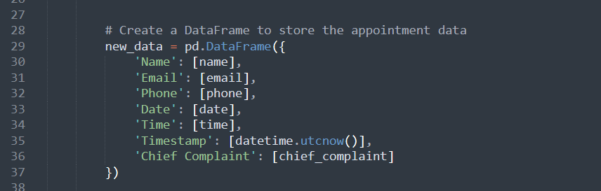
Using the pandas library in python , here we are creating a new Dataframe to store the appointment data and we named the variable as new_data.
These are presented as key:value pairs.
The DataFrame has the following columns:
'Name': Contains a list with a single element, the value of the 'name' variable.
'Email': Contains a list with a single element, the value of the 'email' variable.
'Phone': Contains a list with a single element, the value of the 'phone' variable.
'Date': Contains a list with a single element, the value of the 'date' variable.
'Time': Contains a list with a single element, the value of the 'time' variable.
'Timestamp': Contains a list with a single element, the current UTC timestamp obtained using datetime.utcnow().
'Chief Complaint': Contains a list with a single element, the value of the 'chief_complaint' variable.

Slide 13
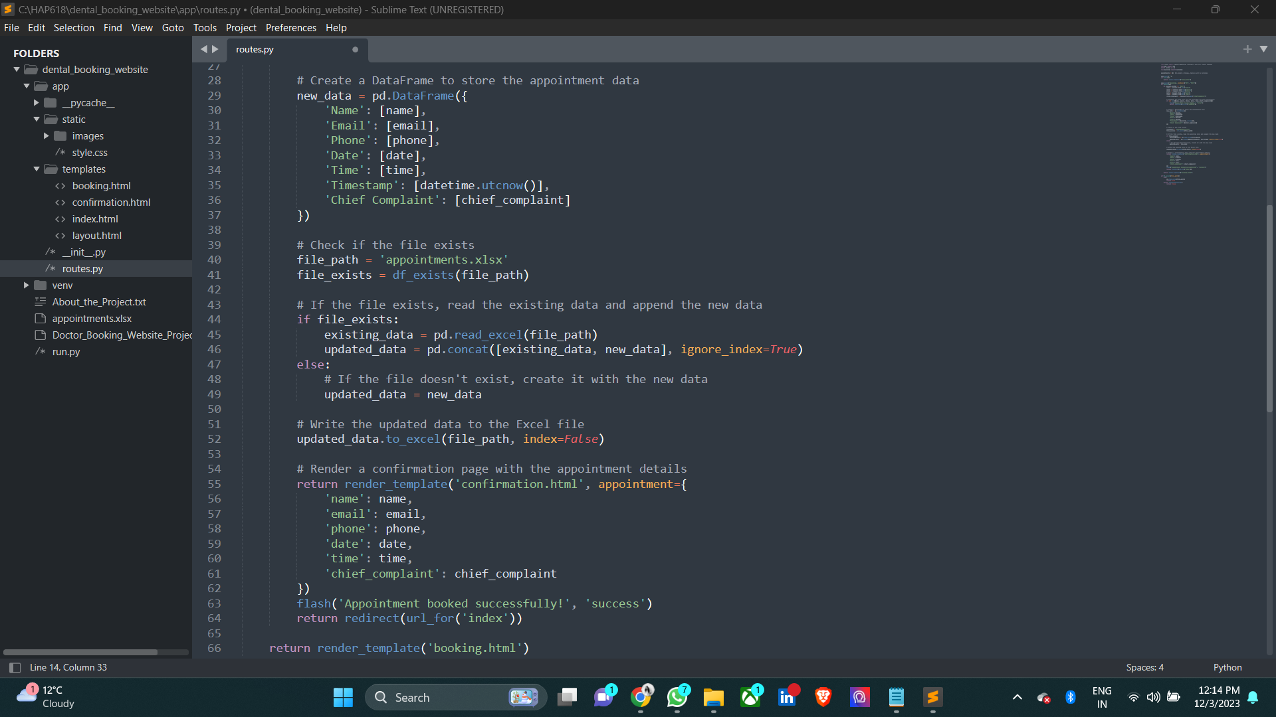
Here we check if the excel file exists , If the file exists (if file_exists is True), it reads the existing data from the Excel file using pd.read_excel(file_path).The data is stored in the DataFrame named existing_data.
It concatenates the existing data (existing_data) with the new data (new_data) using pd.concat.
If the file doesn't exist (else), it assigns the new data directly to updated_data. This means that a new file will be created with the new data.The combined or new data (updated_data) is written back to the Excel file using updated_data.to_excel(file_path, index=False).
The index=False parameter ensures that the DataFrame index is not included in the Excel file
If the file exists, it reads the existing data, appends the new data, and creates an updated DataFrame.
If the file doesn't exist, it creates a new DataFrame with the new data.
The final DataFrame (updated_data) is then written back to the Excel file, effectively updating the file with the new or appended data

Slide 14
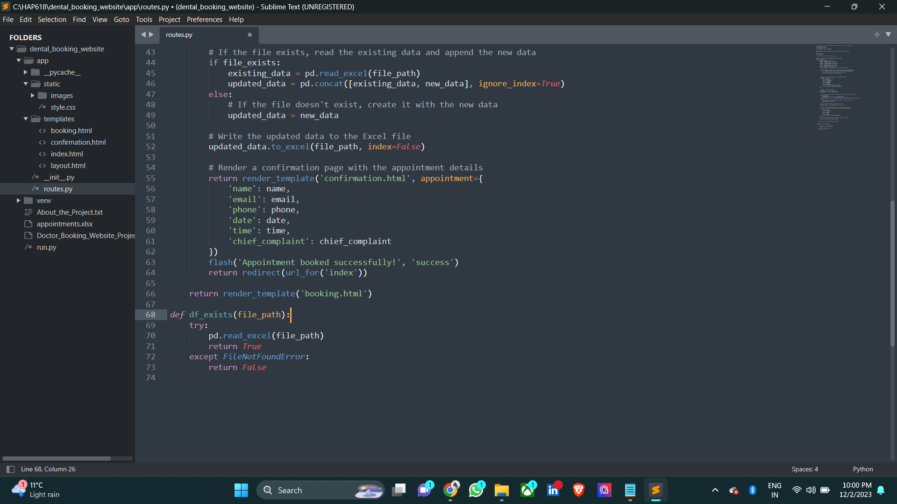
This line renders the 'confirmation.html' template and passes appointment details as a dictionary to be displayed on the confirmation page. The confirmation page will shoe details in the shown format. A flash message is rendered 'Appointment booked successfully' and the page is redirected to the index.html page which is the home page.

Slide 15
In this code we use try block in python.
pd.read_excel(file_path): This Pandas function attempts to read an Excel file located at the specified file_path and returns True if the file exists in the given path.
If the pd.read_excel operation encounters a FileNotFoundError, it jumps to the except block and it returns False.
The df_exists function uses a try-except block to attempt reading an Excel file.
If the file is successfully read, the function returns True, indicating that the DataFrame exists.
If a FileNotFoundError occurs, the function returns False, indicating that the DataFrame does not exist at the specified file path.

Slide 16
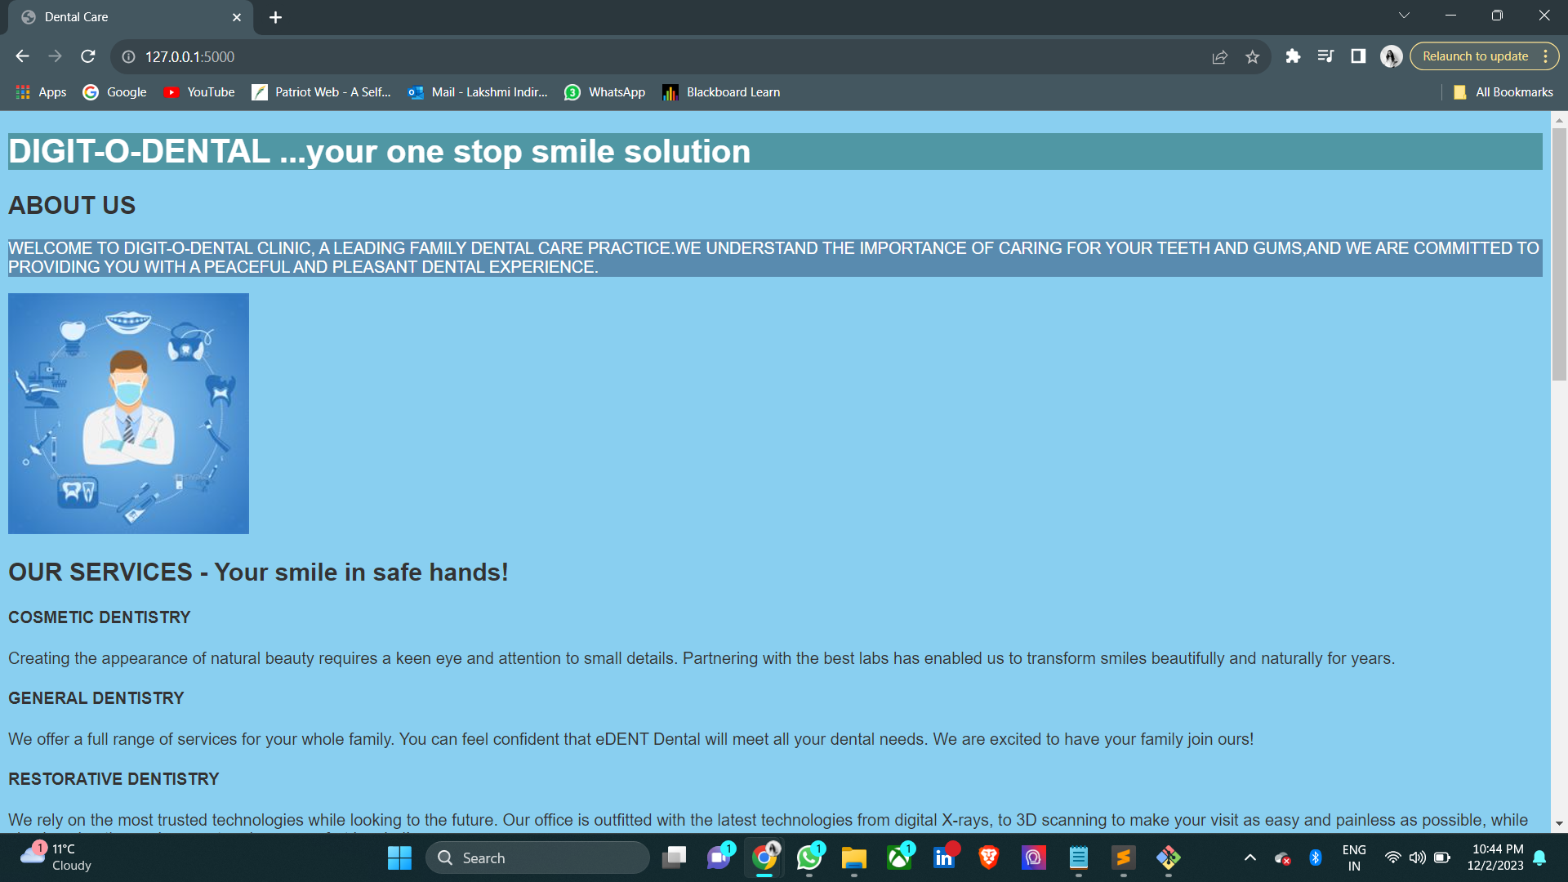
HTML Code
The html code contains responsive designs with meta tags.
External stylesheets for custom and font-awesome styles where the fonts, background colors are saved. Animated transitions using GSAP and Animate.css.
There are several sections like About, Services, Booking Form, Additional Information, and Image Gallery. Custom-styled submit button for the booking form is incorparated.

Slide 17
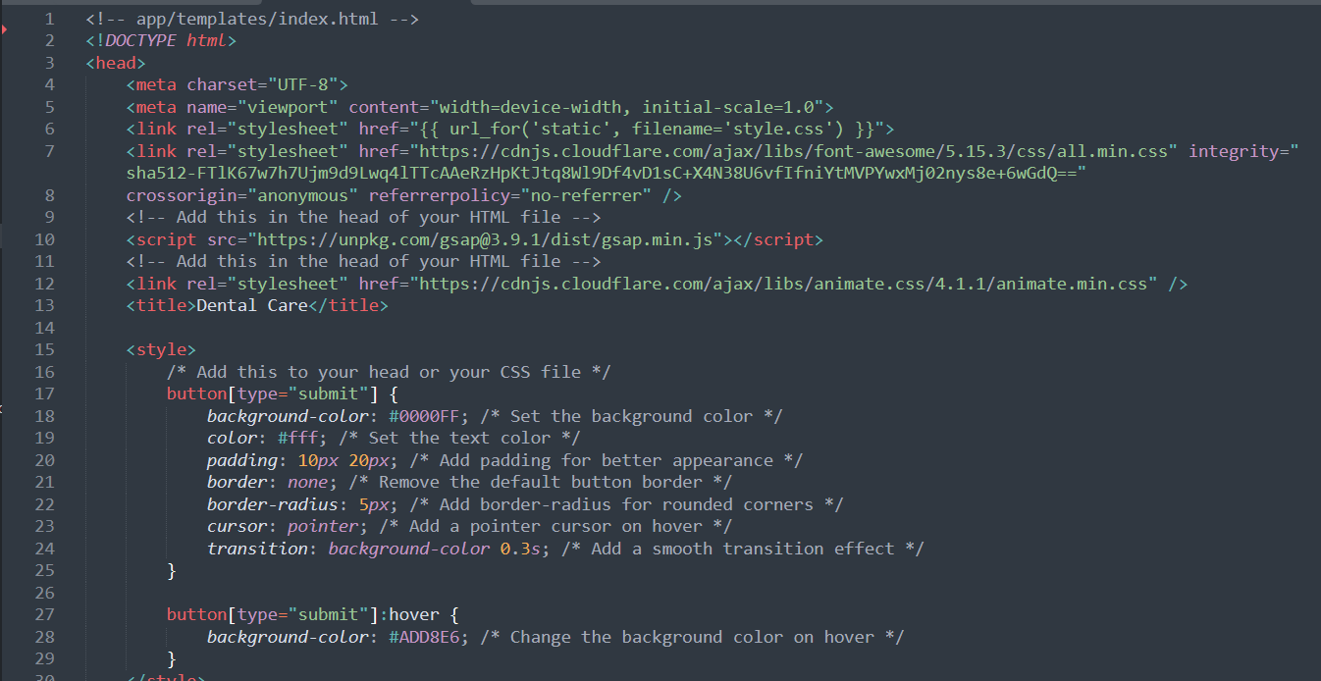
I have used Bootstrap for the web development.
Bootstrap is a free front-end framework, with the purpose of making web development faster and easier. It also includes HTML and CSS-based design templates for forms, typography, buttons, navigation, tables, modals, image carousels, and many other components.
Using Bootstrap ,I have updated the styles in the static/css/style.css file . It is used to define a color scheme to customize styles which will enhance the overall visual appeal.
Integrated relevant images and icons. I have used the url_for function to generate URLs for static files where we need to store our images in the static folder.

Slide 18
Functionality Demonstration

Slide 19
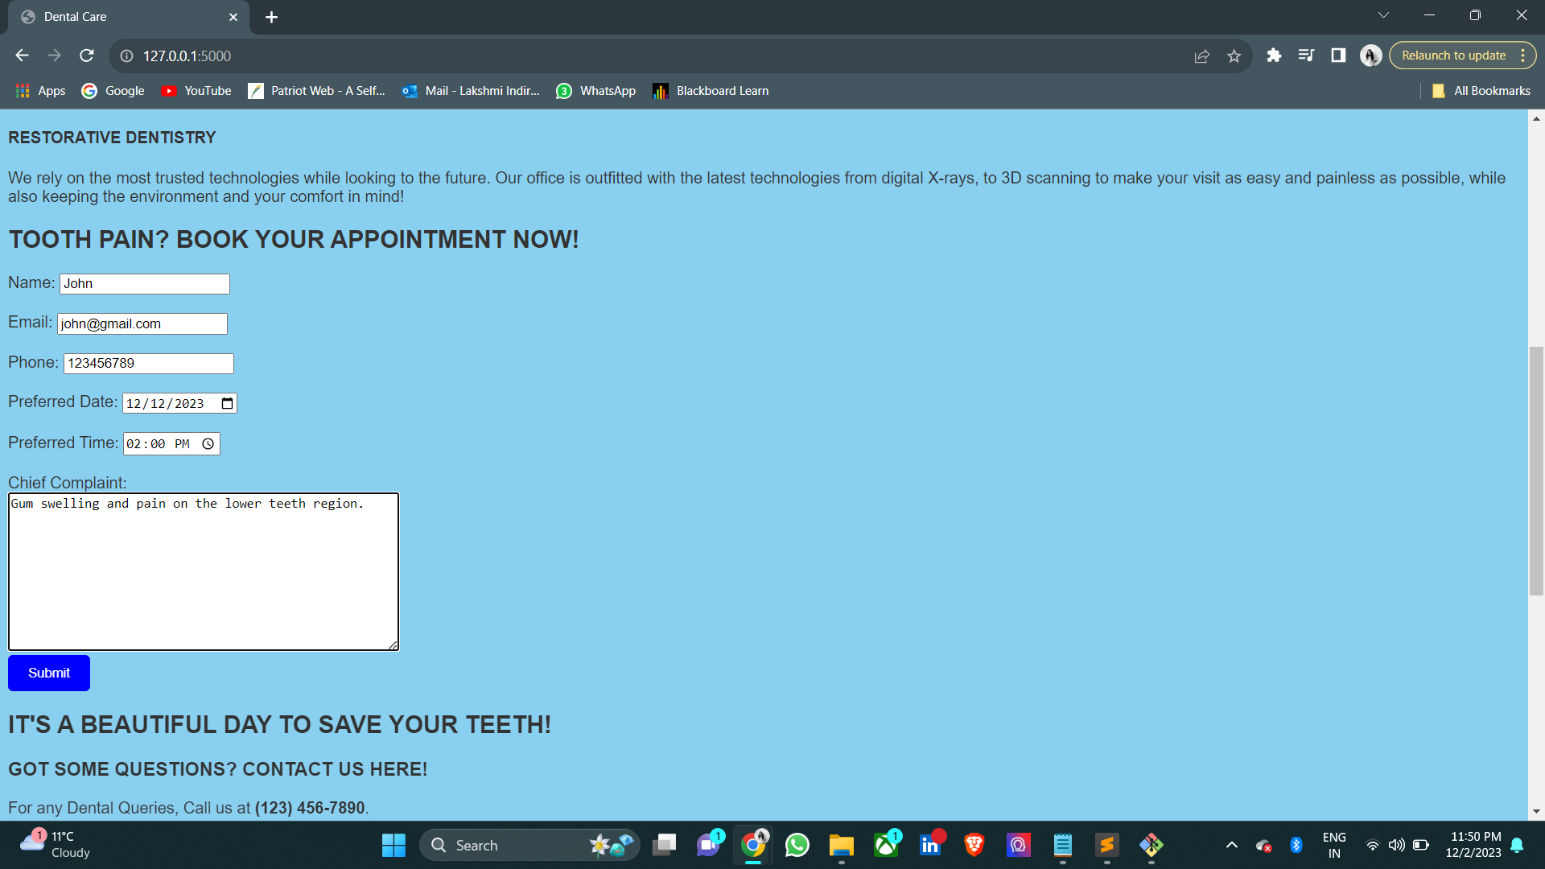
This is how the appointment section looks like on the webpage of the Dental clinic. The Demographic and Diagnostic questionnaire contains, Name, Email, Phone, Preferred Date ,Preferred Time of appointment and the Chief complaint of the patient.
We fill in all the details appropriately and hit the submit button on the bottom.
This is redirected to a new confirmation page.

Slide 20
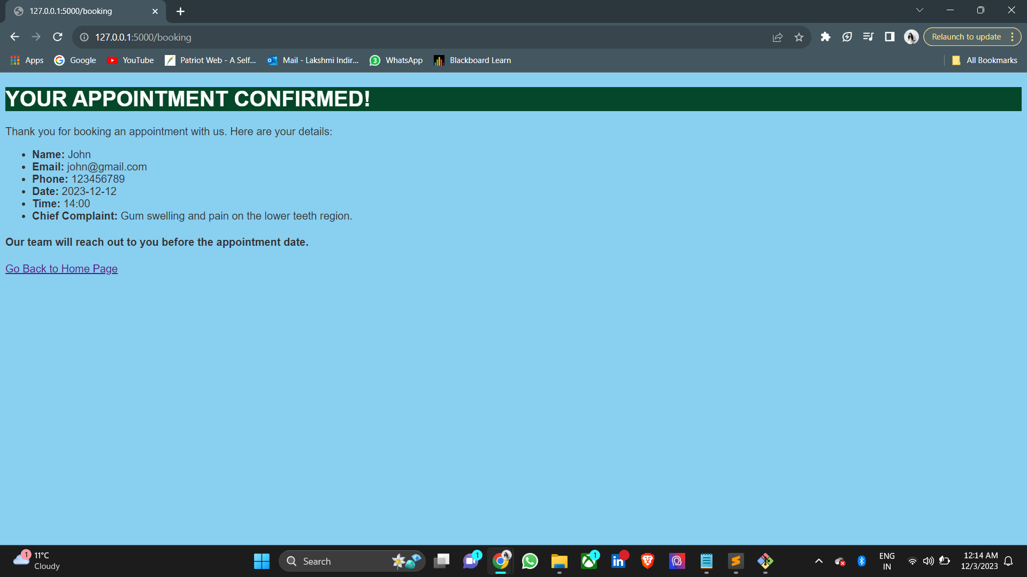
By clicking on Submit. We will receive the appointment confirmation page.
In this page we will have all the details displayed.
And an option to return to home page is available.
This information is saved into an Excel file name 'appointment.xls'

Slide 21
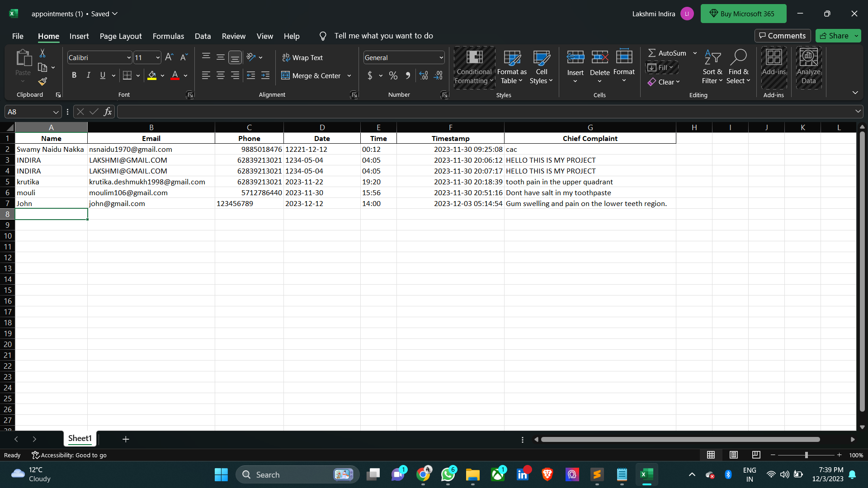

Slide 22
COMPLETE DEMONSTRATION OF THE WEBPAGE AND APPOINTMENT BOOKING SYSTEM IS SHOWN

Slide 23
LESSONS LEARNT WHILE DOING THIS PROJECT.
Coming from a dental background, I've gained proficiency in various Python libraries, HTML tags, and CSS. Additionally, I've delved into the Flask framework for web development. Also in using tools like Git bash and Sublime Text Editor.
Ensuring effective form validation and error handling is paramount for delivering a smooth user experience. Leveraging frameworks such as Flask or similar libraries can streamline the process of form validation. Use of Bootstrap in the web development.
Consistent testing of the application, particularly when implementing new features or significant updates, is essential for enhancing functionality and user satisfaction.

Slide 24
FUTURE ENHANCEMENTS
Implement a user authentication system to allow patients and clinic staff to have personalized profiles.
Users can view their appointment history, update personal information, and manage preferences.
Integrate a notification system to send reminders and confirmations to patients about upcoming appointments.
Allow patients to choose their preferred notification methods (email, SMS, app notifications).
Extend the system to support online consultations and telemedicine services for patients who may prefer virtual appointments.
Allow users to choose their preferred language for the interface.

Slide 25
REFERENCES
https://flask.palletsprojects.com/): Official documentation for the Flask web framework.
https://getbootstrap.com/docs/5.1/): Documentation for the Bootstrap framework, which provides styles and components for building responsive web pages.(https://pandas.pydata.org/pandas-docs/stable/): Pandas library, which is used for data manipulation and analysis.
https://animate.style/: A library for adding CSS animations to HTML elements
www.google.com for the images
Class notes for Python and html codes.

Slide 26


THANK YOU

